Slide 1
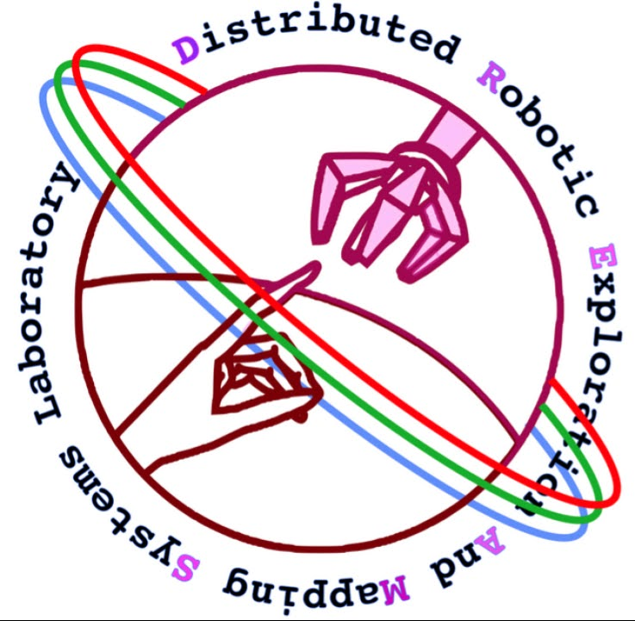
Autonomous High-Altitude Balloon Payload
Anyell Mata Jnaneshwar Das, PhD 2024 Statewide Symposium
April 20, 2023
Notes:
A small angle approximation 5th order approximation control system of a quadcopter was utilized. Single yaw-axis movement between setpoints can vary due to changes to angular momentum. The control system prioritizes following the trajectory setpoint to a certain degree. The control system was developed using Gazebo simulations and had been adapted to a quadcopter airframe and implemented using PixHawk drone hardware and an offboard Raspberry Pi 4. The control law is designed to reference GPS data and the position of the Sun which will send position and trajectory commands to the control. The yaw position commands are controlled by a Proportional-Integral-Derivative (PID) controller and an Extended Kalman-Filter (EKF) filter for the local sensors. The roll and pitch axes are to be objectively ignored. Progress of the software/middleware adaptation shall be discussed.

Slide 2
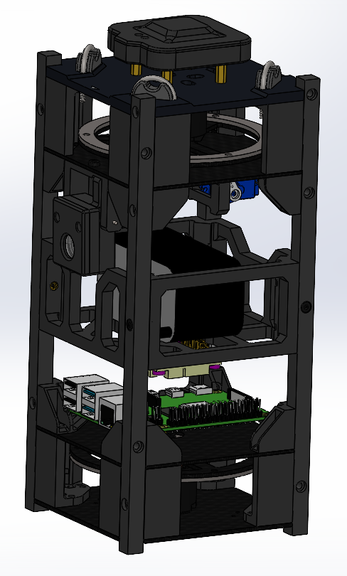
Agenda
Mission Statement
System
Block Diagram
Communication
Capabilities
Methodology
Rotational Motion
Stabilization Analysis
Testing
Conclusion
Source: Scott Clemens

Slide 3
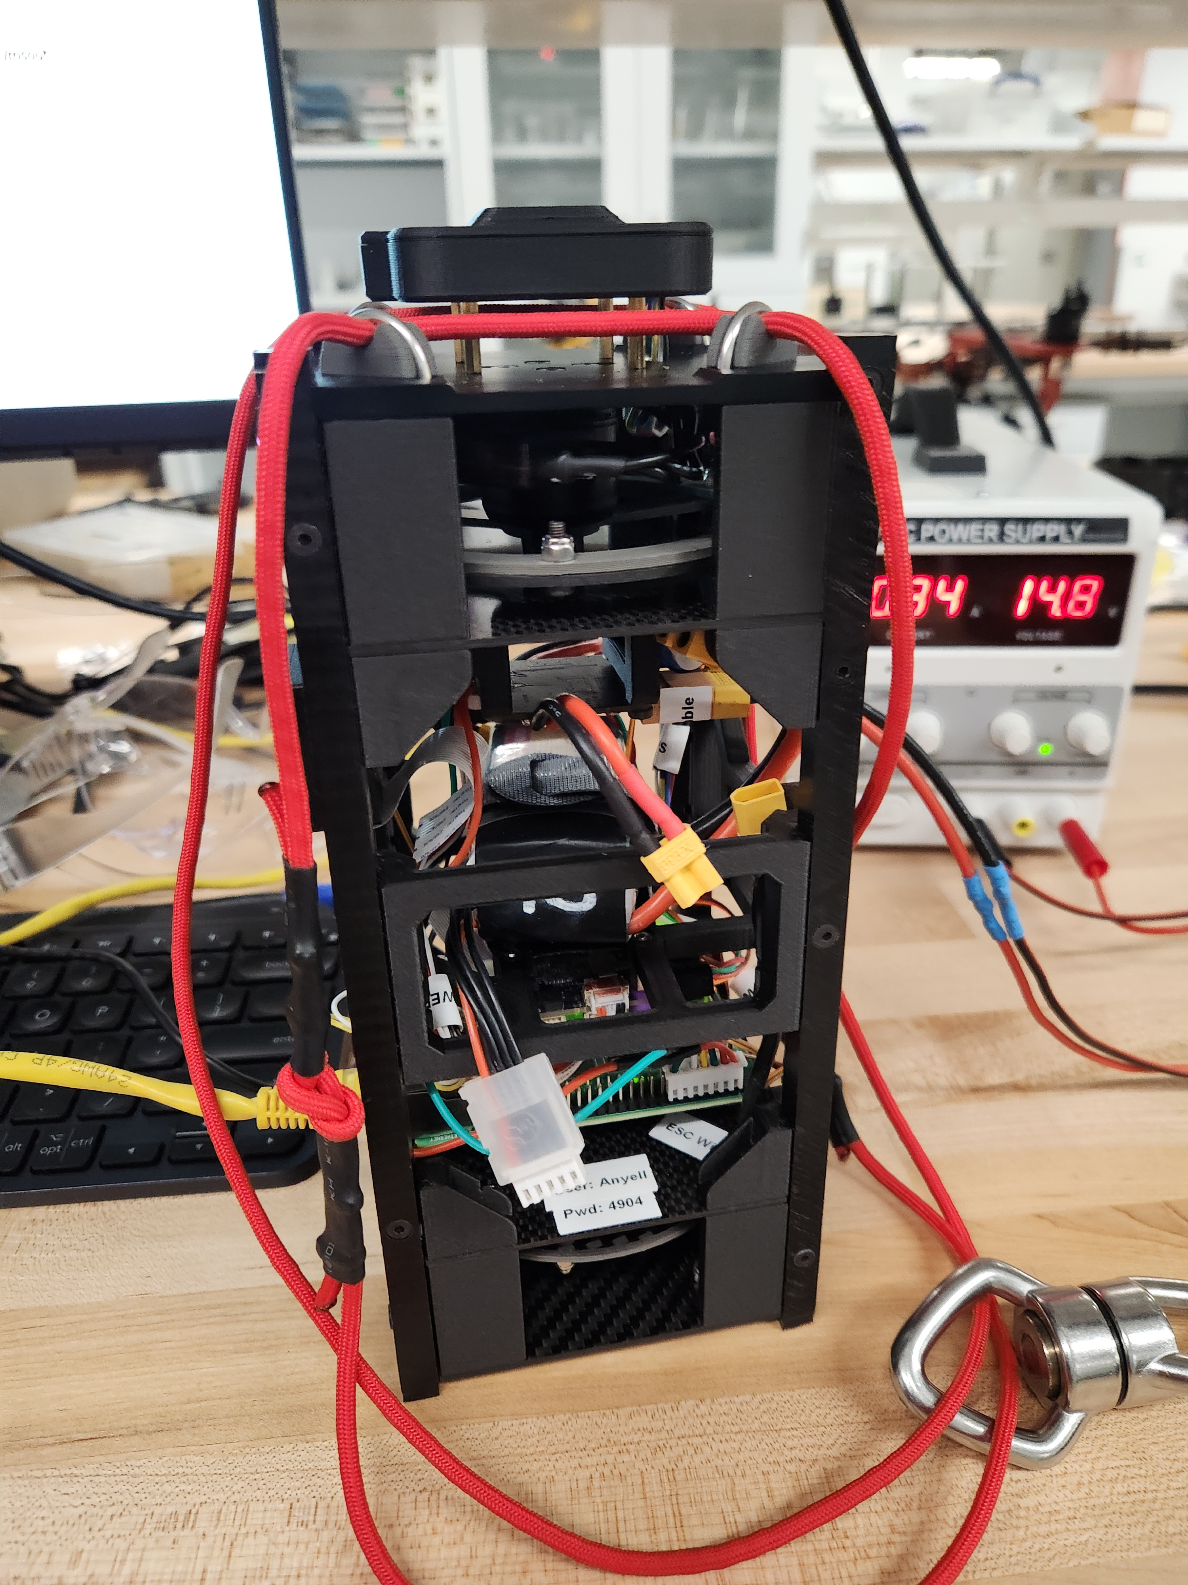
Mission Statement
Objectives
Utilize Reaction Wheels to Stabilize Payload across Yaw Dimension
Identify Sun’s Location and Payload Heading
Expand on Payload Airframe
Identify Ascent Conditions from Flight Data

Slide 4
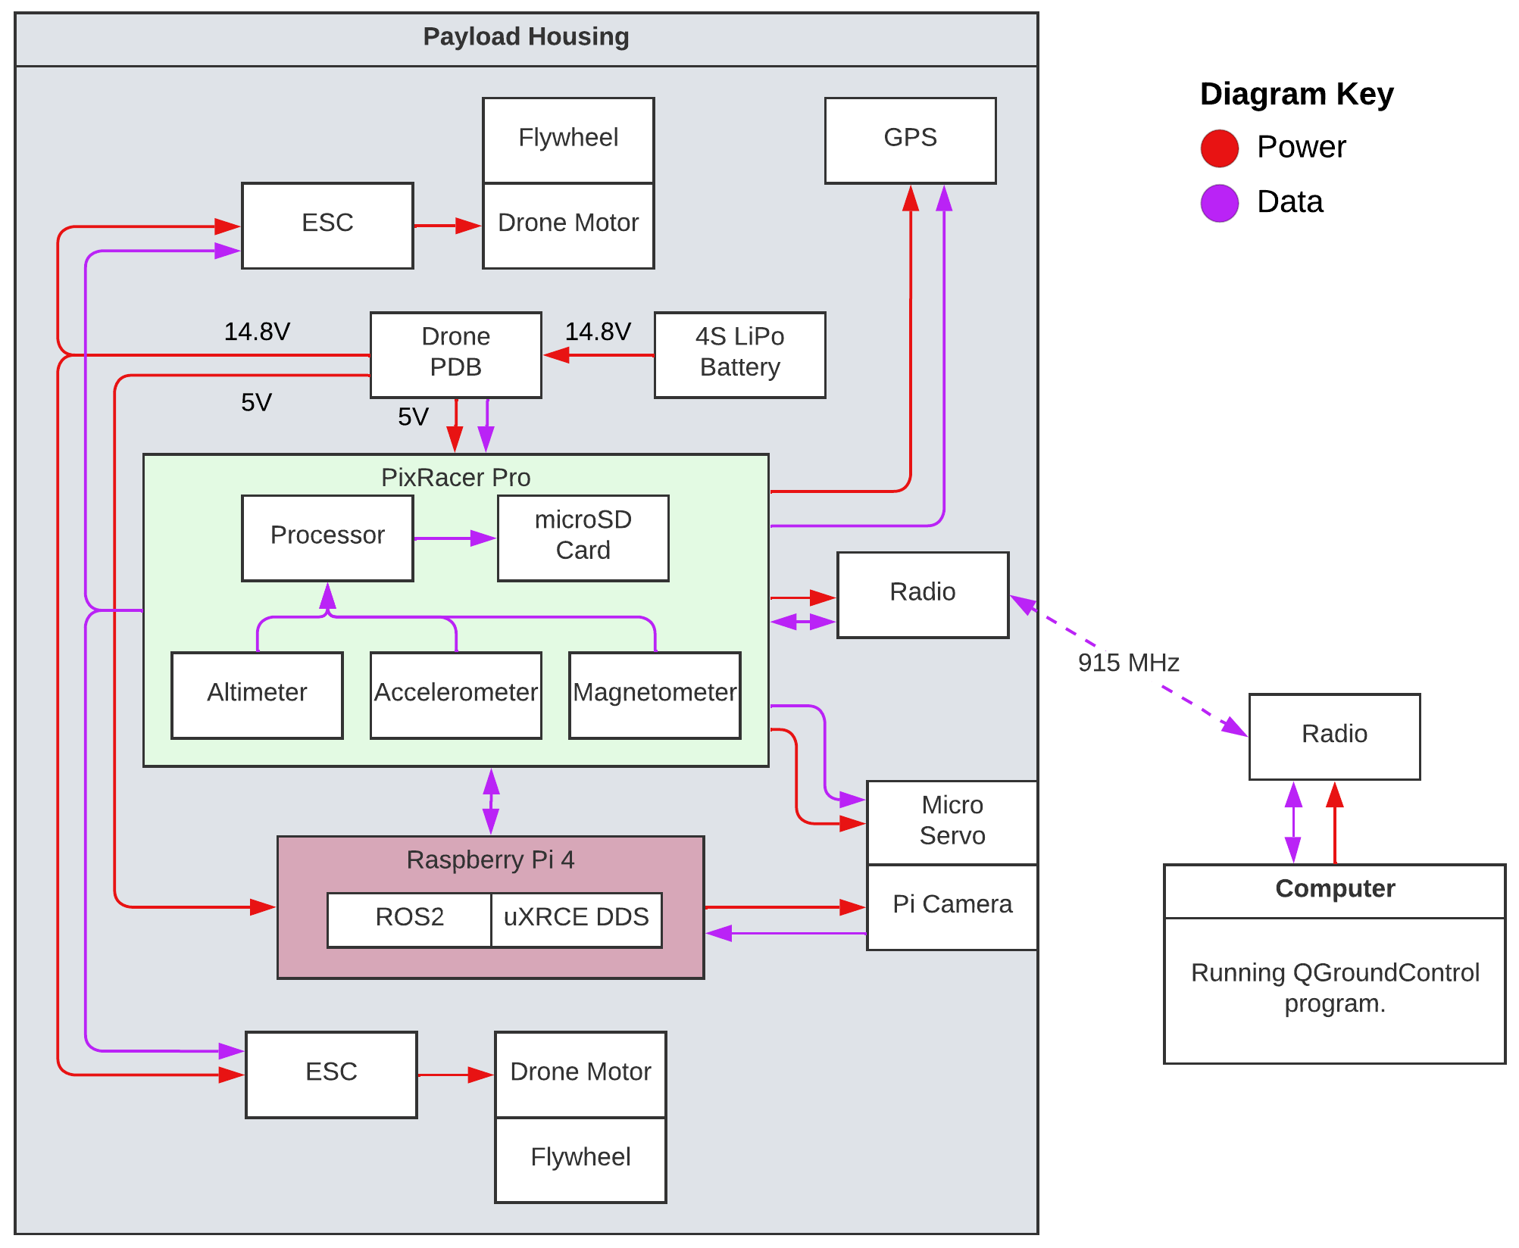
System
System Block Diagram
Drone Parts
Open-Source Software
PixRacer Pro:
Proportional–Integral–Derivative (PID) Controller
Extended Kalman Filter (EKF) Algorithm
GPS + Compass
Raspberry Pi 4:
22.04 Ubuntu
Robotic Operating System (ROS) 2
Pi Camera V2

Slide 5
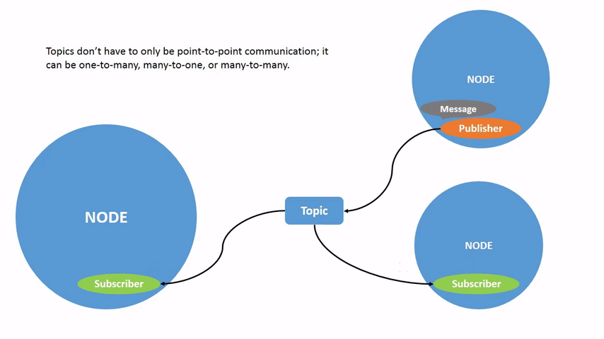
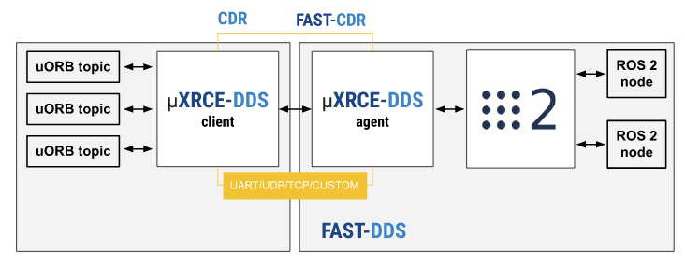
System
Communication
Middleware Protocol:
eProsima’s Micro XRCE-DDS
Client: PixRacer Pro
Agent: RPi4
Subscriber / Publisher Functionality
Source: ROS2
Source: ROS2

Slide 6
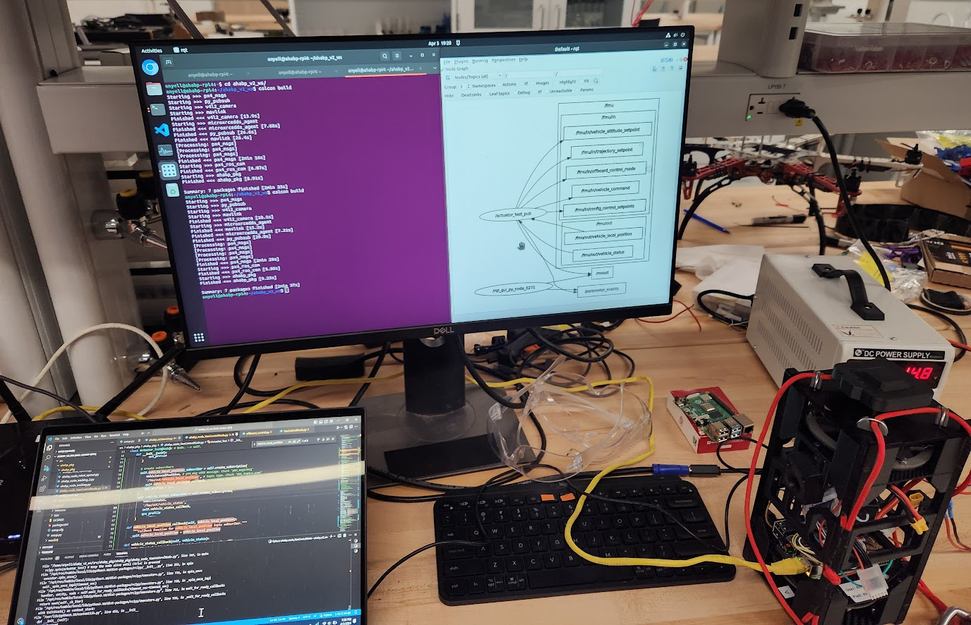
System
Capabilities
Weighs ~3 Lbs.
3-Hour Battery Life
Expected Flight Duration
Atmospheric Sensing
Conditional Flight Actions
Topic Communication across Wifi

Slide 7
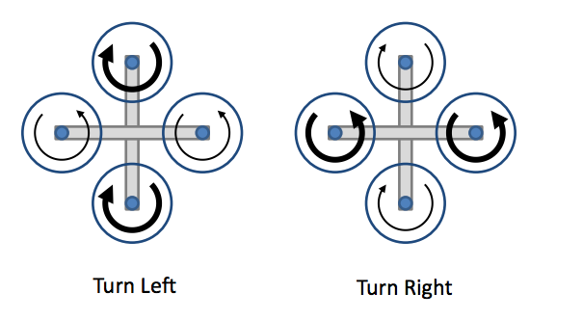
Methodology
Rotational Motion
Equation for Angular Velocity
$$ω_{p}=\frac{I_{1,2}}{I_{p}}{∗(ω_{1}−ω}_{2})$$
Where:
$ω_{p}$: payload angular velocity
$ω_{1}$: motor #1 angular velocity
$ω_{2}$: motor #2 angular velocity
$I_{1,2}$: combined motors rotational inertia
$I_{p}$: payload rotational inertia
Equation for Manual Trajectory
P + I controller:
$$u\left(t\right)=K_{p}e\left(t\right)+K_{i}\int{e\left(t\right)dt}$$
Where:
$K_{p}$: proportional gain
$K_{i}$: integral gain
$e\left(t\right)$: error value
$dt$: change in time
Source: Robotics Stack Exchange
Notes:
A controller with derivative (or rate) action looks at how fast the process variable changes per unit of time, and takes action proportional to that rate of change. Contrast that to integral (reset) action, which represents the “impatience” of the controller, derivative (rate) action represents the “cautious” side of the controller.

Slide 8
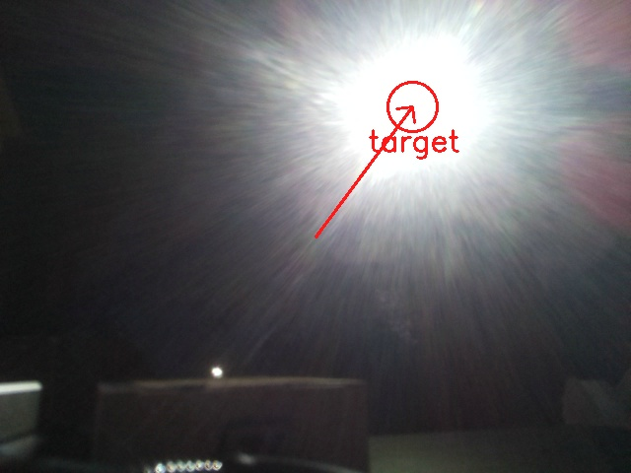
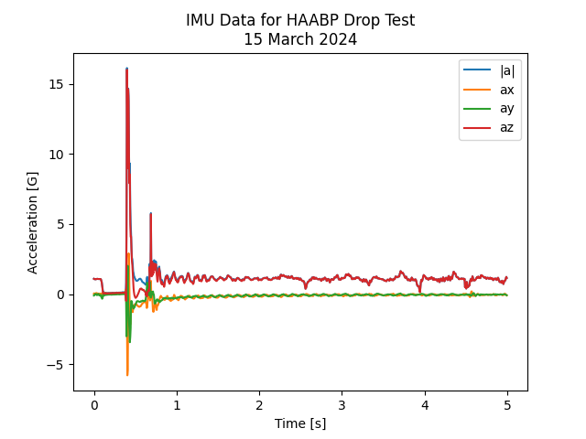
Testing
Vacuum, Thermal, Tracking, Drop Test
-50⁰ C for 15 Minutes
20-Foot Drop Test
Flashlight Tracking Using OpenCV
Manual Control Tests at 1,000 Pascals
Source: Scott Clemens

Slide 9
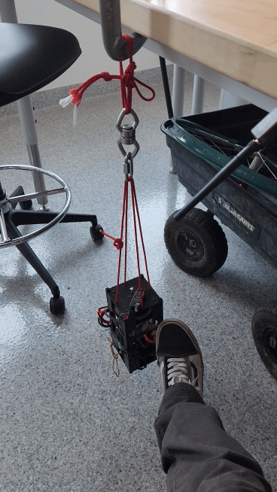
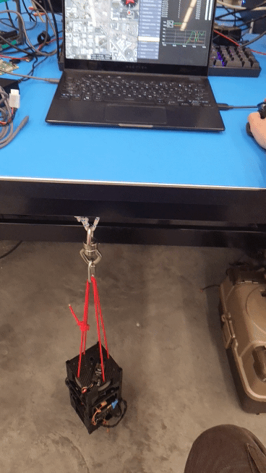
Testing
Stabilization Analysis
Stabilized Mode on PX4 Platform
Oscillations from Overshoot
No Dampening
Slower Velocity for Tracking Method

Slide 10
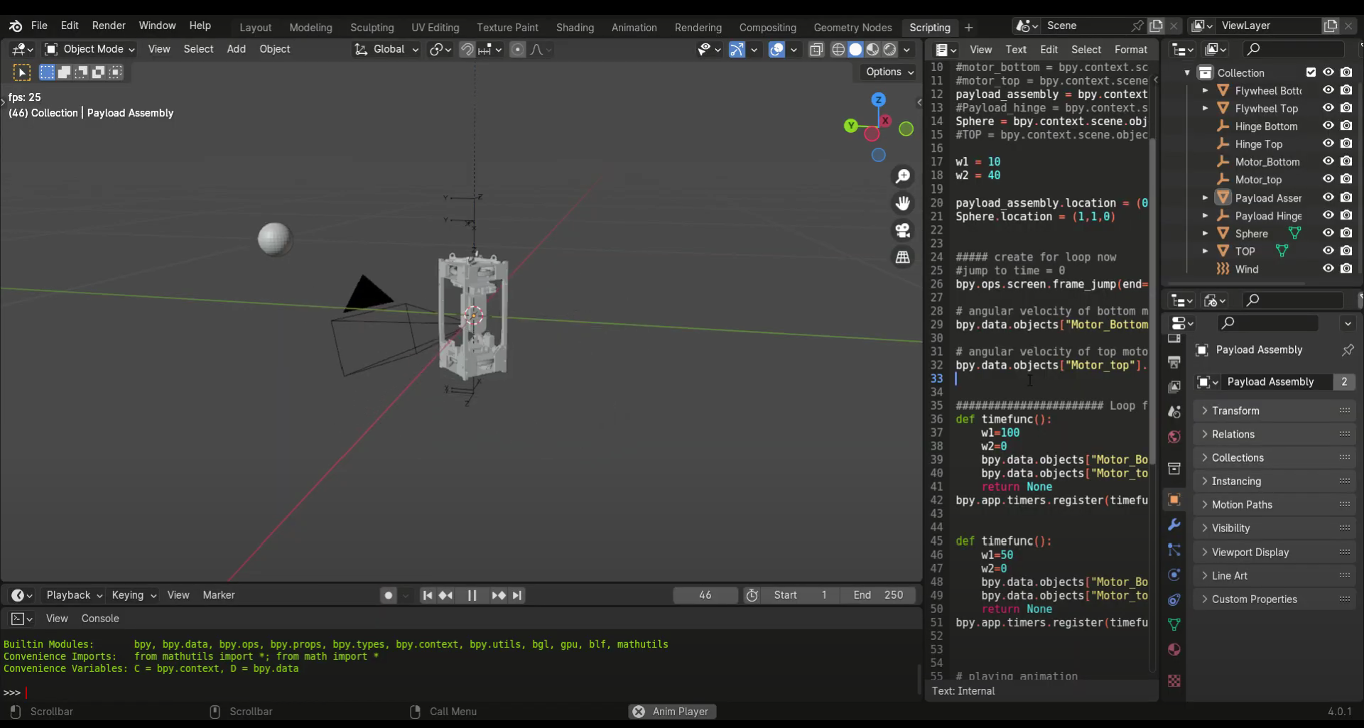
Conclusion
Final Remarks
Emphasis on the Feasibility of Hardware Integration
Open-Source Equipment
Airframe Model Adaptation is Extensive
Extra Considerations for Autonomous Systems
Failsafes, Vehicle Status, Constant Signal
Future Work
Prepare for ASCEND Launch
Further Develop ROS2 Launch File
Expand Gazebo Simulations
Source: Bryan Correa & Truman Padgett

Slide 11
Acknowledgements
Special Thanks To:
Dr. Jnaneshwar Das
ASU/NASA Space Grant
Scott Clemens
Bryan Correa
Truman Padgett
Dreams Laboratory
Interplanetary Initiative Laboratory

